Slide 1
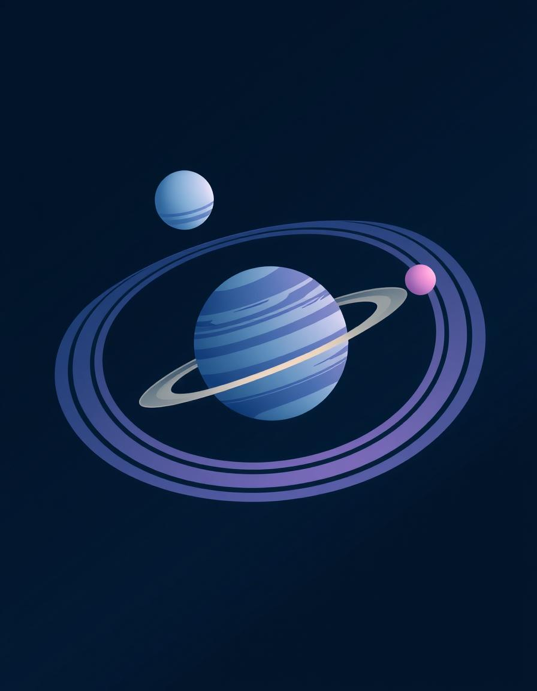
Realistic 3D SolarSystem
Course name : Computer Graphics & Image Processing
Presented by :
Md mahdi islam
221-115-104

Slide 2
Title: Project Objective
Create a realistic 3D solar system simulation.
Simulate planetary rotation, orbit, axial tilt, and rings.
Include dynamic asteroid belt with variety in size, shape, and color.
Implement interactive camera control and adjustable simulation speed.

Slide 3
🌍 1️⃣ Introduction
The project visualizes a realistic 3D solar system model using OpenGL.
Each planet orbits around the sun with its own speed, tilt, color, and moons.
Includes a colorful asteroid belt between Mars and Jupiter for realism.
User can interact — pause/resume, zoom in/out, rotate camera, toggle labels and orbits.
Aim: Demonstrate core computer graphics transformations and animation

Slide 4
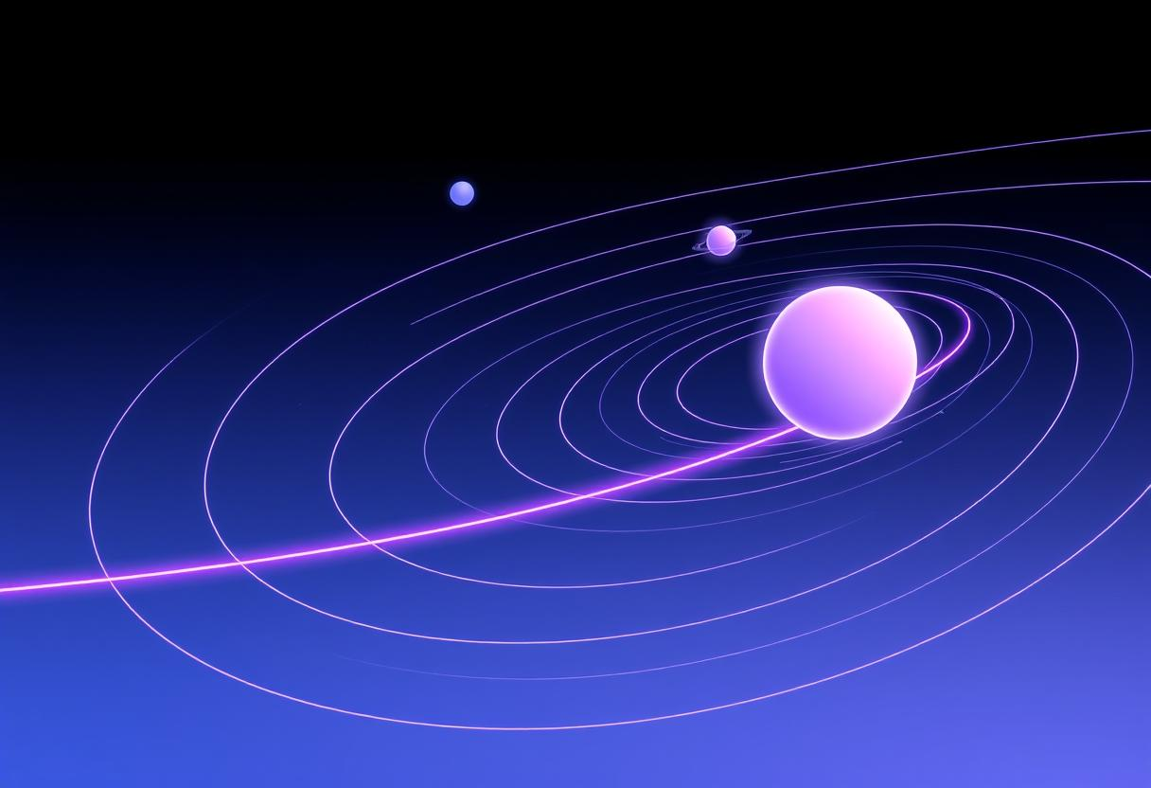
🧮 2️⃣ Methodology
Steps Used:
Modeling:
  Planets, moons, and asteroids created using 3D primitives (glutSolidSphere).
Lighting & Materials:
  Realistic shading using glMaterialfv() and glLightfv().
Transformations:
  glRotatef() → Rotation of planets and camera
  glTranslatef() → Orbit movement
  glScalef() → Asteroid shape variation

Slide 5
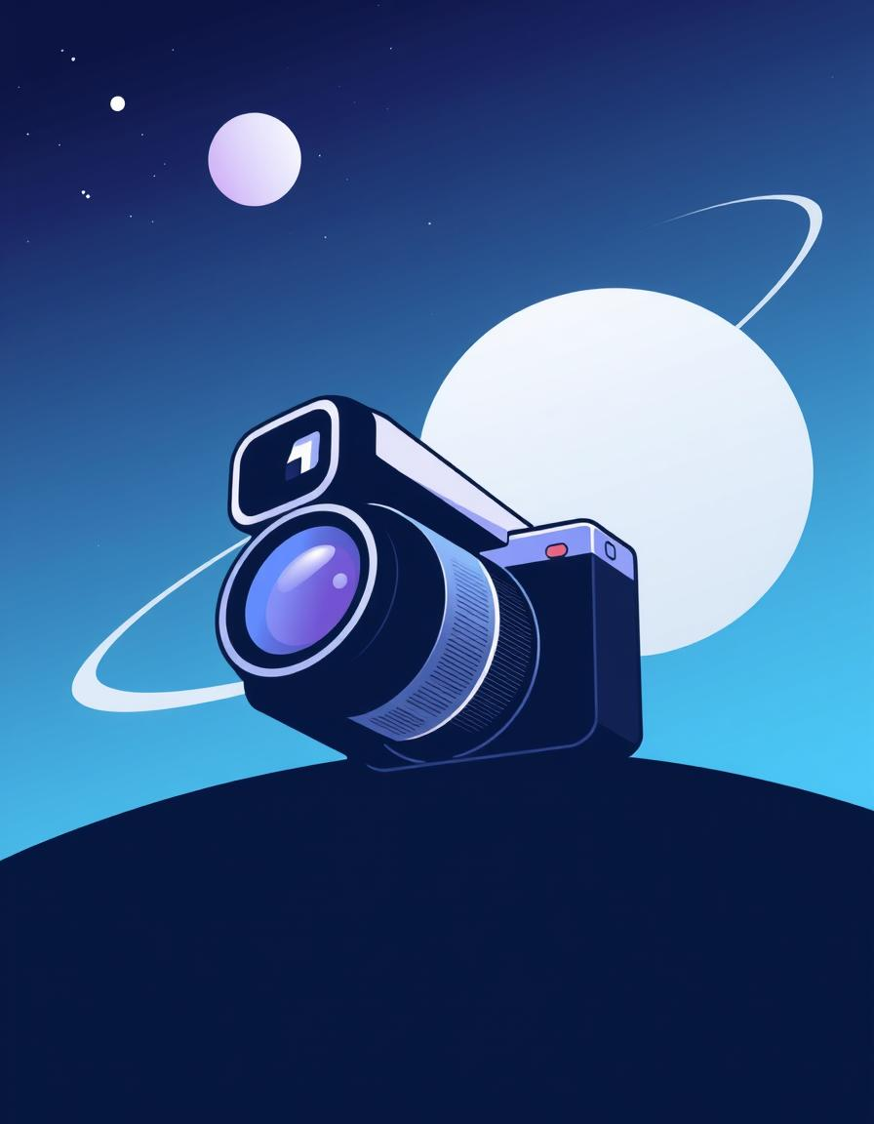
4. Animation:
  Continuous update with glutTimerFunc() (approx. 60 FPS).
  Planet rotation & orbit speed updated per frame.
5. User Interaction:
  Keyboard → Pause, speed, toggle orbits/labels
  Mouse → Camera rotation & zoom

Slide 6
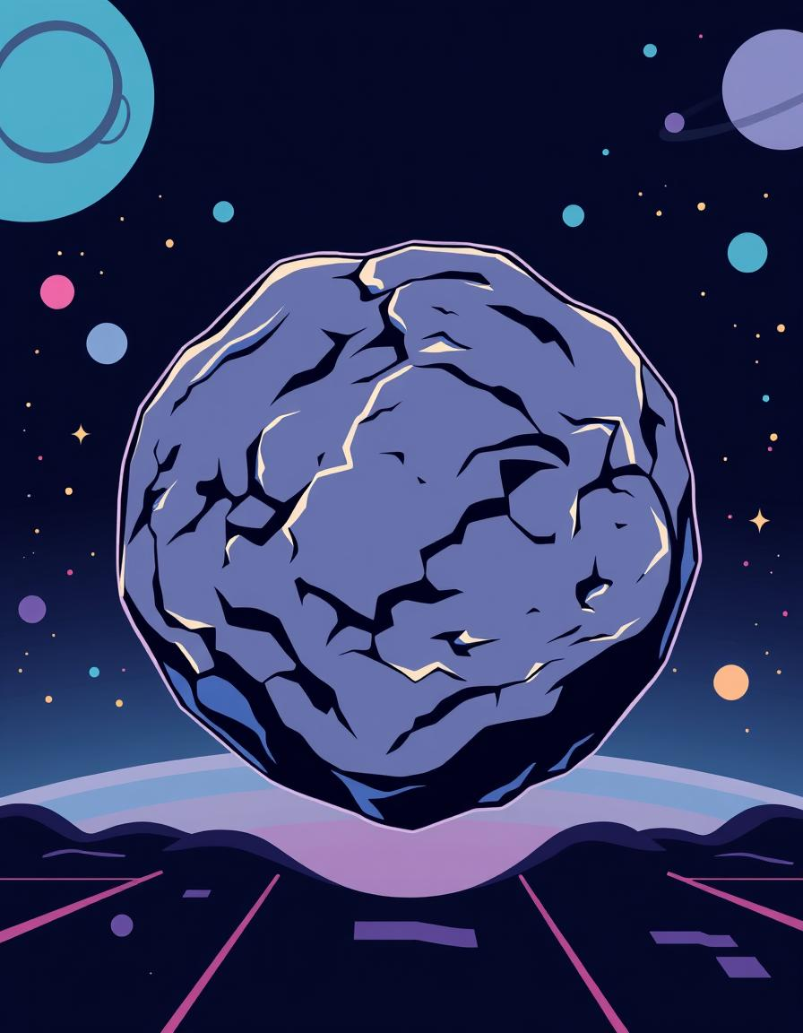
🧰 3️⃣ Tools and Technologies
C++
C++
Category | Tool / Library
Programming Language | C++
Graphics API | OpenGL (GLUT)
IDE / Compiler | Codeblocks,VsStudio,Dev-c++
OS Compatibility | Windows/Linux
Supporting Libraries | <Gl/glut.h>,<cmath>,<vector>

Slide 7
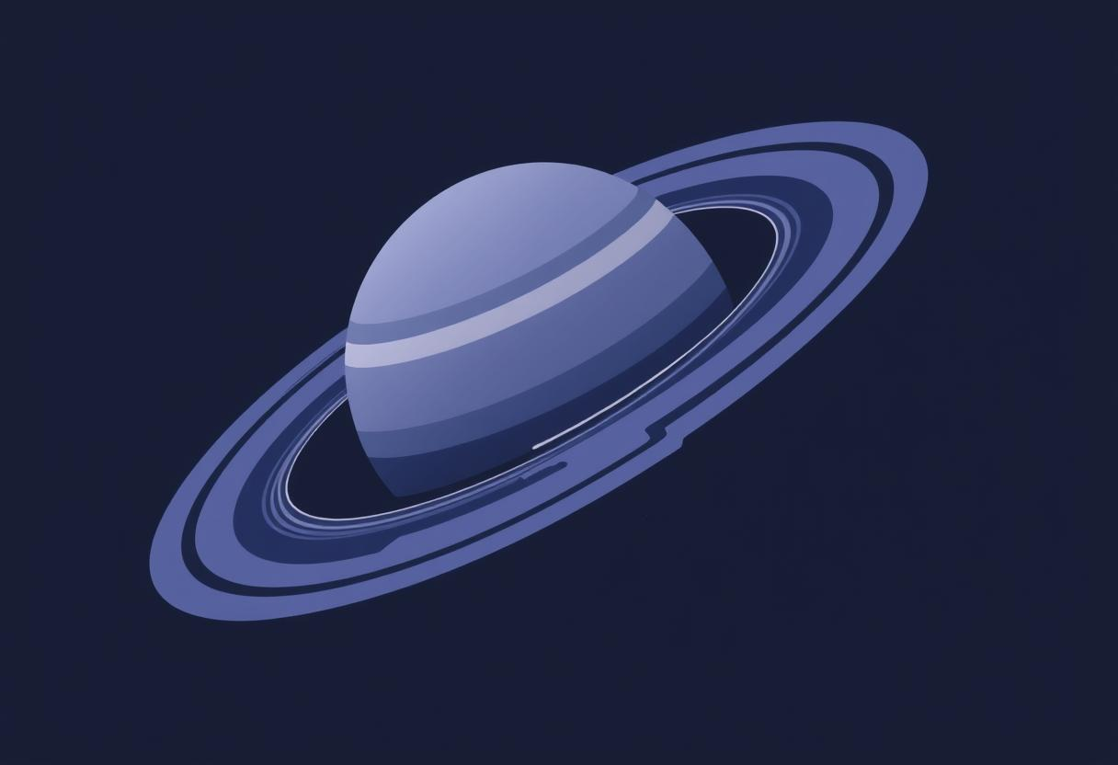
⚙️ Algorithms & Concepts Used
Concept | Description
Transformation Algorithms | Rotation, Translation, Scaling
Lighting Model | Phong Illumination (Ambient, Diffuse, Specular)
Animation Loop | Timer-based update using glutTimerFunc()
Camera Control | gluLookAt() for dynamic 3D viewing
Randomization | Used in asteroid position, color & spin
Data Structures | Struct palent & struct asteroids for modular design

Slide 8
🪐 Shapes and 3D Objects Used
Object | Shape Used | Function
Sun & Planets | Sphere (glutSolidSphere) | Body modeling
Moons | Small spheres | Orbit around planets
Asteroids | Scaled spheres | Random irregular rocks
Orbits | Line loops | Visual orbit paths
Saturn’s Rings | Torus (glutWireTorus) | Realistic ring effect
Stars | Random points | Background aesthetic

Slide 9
🧩 Relation to Computer Graphics Course Topics
Course Topic | Applied in Project
2D & 3D Transformations | Rotation, translation, scaling of planets
Viewing & Projection | gluPerspective() and glOrtho()
Illumination Models | Ambient, Diffuse, Specular lighting
Modeling & Shading | Sphere, Torus modeling, realistic materials
Animation & Interaction | Timer-driven motion, keyboard & mouse controls
Color Theory | RGB color customization per planet & asteroid

Slide 10
🛰️ Working Principle
Initialization:
  OpenGL lighting, color, and projection setup.
Rendering Loop:
  Each frame: draw sun → asteroid belt → planets + moons.
Transformation:
  Each planet’s position = distance * cos(angle) & distance * sin(angle).
Lighting:
  Single light source at sun’s position.
User Interaction:
  Real-time camera rotation & zoom with mouse.

Slide 11
🌟 Future Scope
Add textured planets using image mapping.
Add comets, stars, and spacecrafts for realism.
Implement sound effects and planet info popups.
Upgrade to modern OpenGL (shaders) for better visuals.
Convert to VR or AR simulation for immersive experience.
🧑‍💻 Conclusion
This project demonstrates core graphics programming skills:
  3D modeling
  Animation
  Lighting & camera control
Enhances understanding of OpenGL pipeline & transformation matrices.
A perfect blend of creativity + technical graphics.

Slide 12
Successfully simulated realistic solar system
Dynamic asteroid belt & rings
User can interact with simulation
Can be extended to:
  Include more moons
  Add comet trails
  Add textures to planets

Slide 13


